Slide 1
Forensic Analysis of Internet Explorer Activity Files
Based on article by
Keith J. Jones
Foundstone
http://www.foundstone.com/pdf/wp_index_dat.pdf

Slide 2
Basics
Internet Explorer
  Market Share
    2002 92.9% (WebSideStory)
    2004 81.4% (www.w3schools.com/browsers/browsers-stats.app) (user bias towards alternatives)
    2007 58.6% (same source)

Slide 3
Basics
Win9* ME | \Windows\Temporary Internet Files\Content.IE.5 \Windows\Cookies \Windows\History\History.IE5
WinNT | \Winnt\Profiles\<user>\Local Settings\Temporary Internet Files\Content.IE5\ Winnt\Profiles\<user>\Cookies\ Winnt\Profiles\<user>Local Settings\History\History.IE5
Win2K WinXP | \Documents and Settings\<user>\Local Settings\Temporary Internet Files\Content.IE5 \Documents and Settings\<user>\Cookies \Documents and Settings\<user>\ Local Settings\History\History.IE5

Slide 4
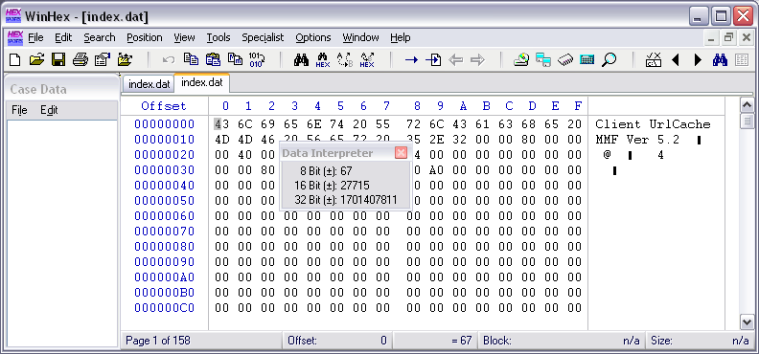
index.dat
File Header
  Contains basic information on the file

Slide 5
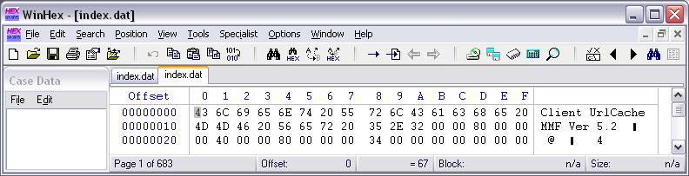
index.dat file header
Null terminated version string.
Followed by file size.
0x 00 80 00 00 →0x 00 00 80 00 (little endian conversion)
→ 32768

Slide 6
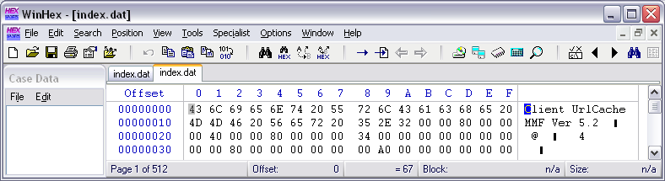
index.dat file header
Bytes 0x20 – 0x23: Location of hash table.
  Hash table is used to store the actual entries.
Go to byte 0x 00 00 40 00

Slide 7
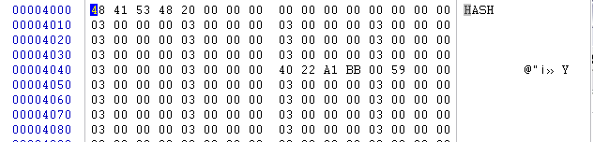
index.dat file header
Beginning of hash table

Slide 8
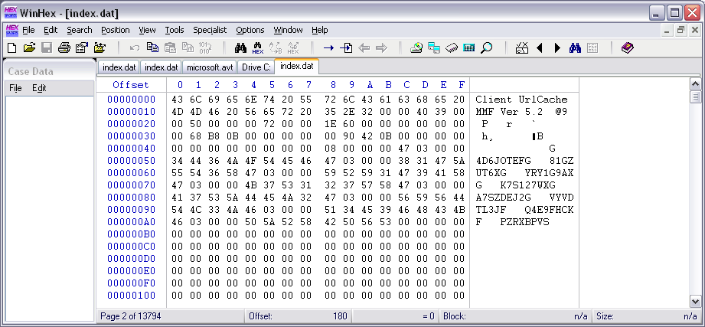
index.dat file header: History

Slide 9
index.dat file header: History
Size: 0x00394000 3751936
Hash Table: 0x00005000
Directories: (null-terminated, 0x50)

Slide 10
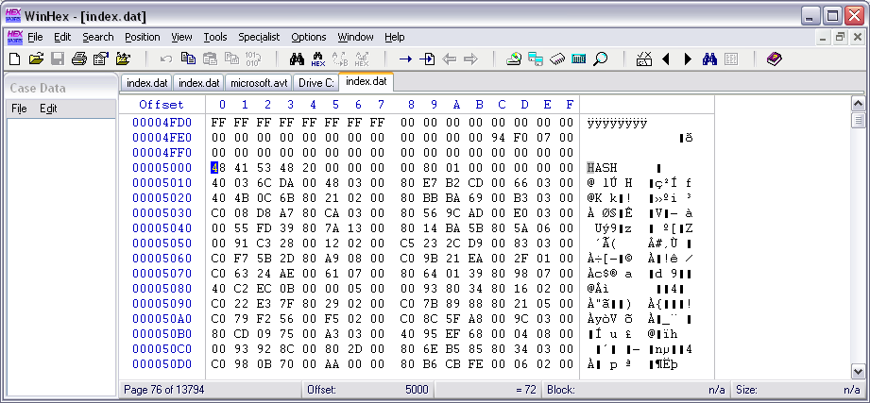
index.dat file
Hash Table:

Slide 11
index.dat file
Hash Table:
  There can be several hash tables. Each one contains a pointer to the next one.
Fields in Hash Table:
  Magic Marker “HASH”
  4B Number of Entries in Hash table.
    Multiply this number by 128B
  Pointer to next hash table

Slide 12
index.dat file
20 entries → Total size of hash table is 32*128B = 4KB
Hash Table:
Next hash table at
0x 00 01 80 00

Slide 13
index.dat file
Hash Table Entries
Field | Offset | Size | Description
Hash Table Length | 4 | 4 | Length of hash table in 0x80 long blocks
Next Hash Table | 8 | 4 | Offset in table to next hash table. Zero values shows that this is the last hash table
Activity Records Flags | 16+8n | 4 | First byte 0x01: record deleted First byte 0x03: Else:
Activity Record Pointers | 20+*n | 4 | Offset of activity record

Slide 14

index.dat file header
Activity flag 40 03 6C DA
Activity record pointer:
00 03 48 00
Go to 00 03 48 00

Slide 15
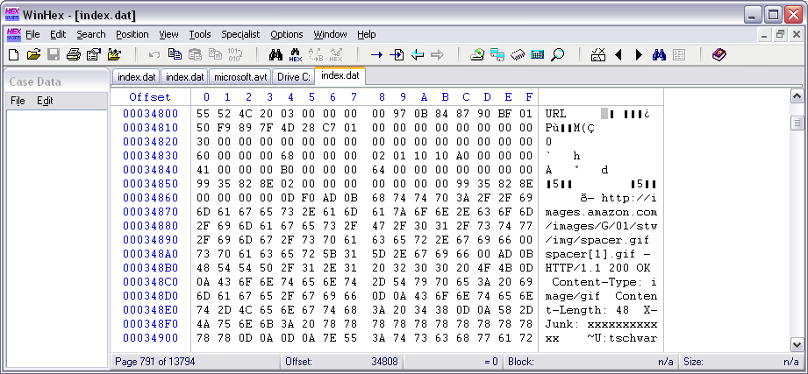
index.dat file header
Go to that location:

Slide 16
index.dat file header
Activity Record
  Type field 4B:
    REDR
    URL
    LEAK
  Length Field 4B:
    Multiply with 0x80
  Data Field

Slide 17
index.dat file header
URL Activity Record
  Represents website visited
  Record Length (4B)
  Time stamps
    8B starting at offset +8 in the activity record:
      Last Modified
    8B starting at offset +16 in the activity record:
      Last accessed
    Organized like file MAC times.

Slide 18
index.dat file header
REDR Activity Record
  Subject’s browser redirected to another site
  Same Type, length, data format
  Followed by URL at offset 16 in activity record

Slide 19
index.dat file header
LEAK activity record
  Same as URL

Slide 20
index.dat file header
Deleted Records:
  Will not show up when consulting IE history.
  But often still there.
  “Delete history” is not rewriting the history file.

Slide 21
index.dat file header
Tool to sort things out:
  PASCO for index.dat
  Galleta for cookies.

